Slide 2









Slide 3
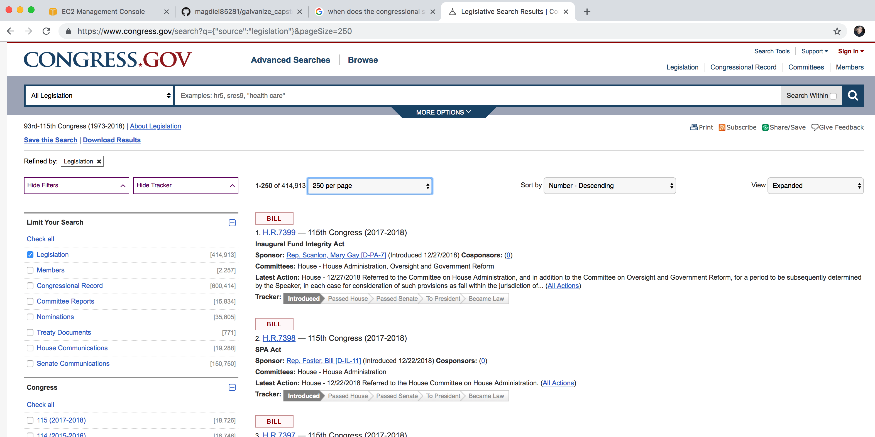
Data Collection

Slide 4
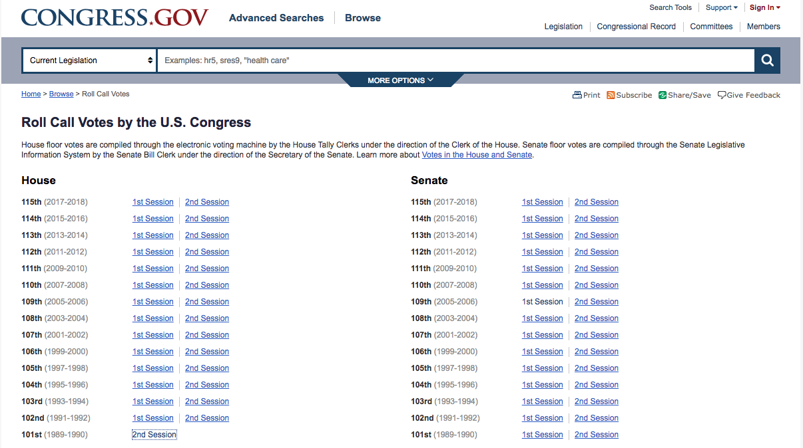
Data Collection
Roll Call Votes are listed by chamber, year, and session.

Slide 5
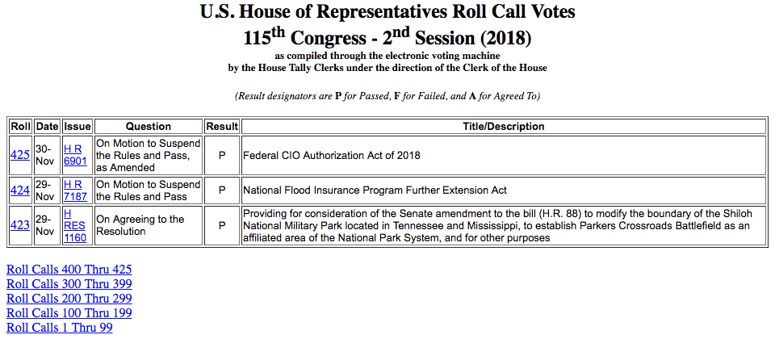
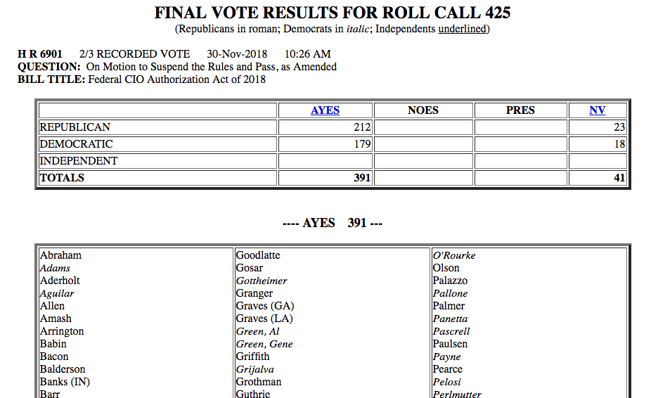
Data Collection
Roll Call Vote summaries are listed in tabular form.
This data was scraped, stored, and formatted.
Roll Call results are listed at the link provided at each Roll number.
This data was also scraped, stored, and formatted.

Slide 6
Data Collection
Roll Call Votes are listed by chamber, year, and session.

Slide 7
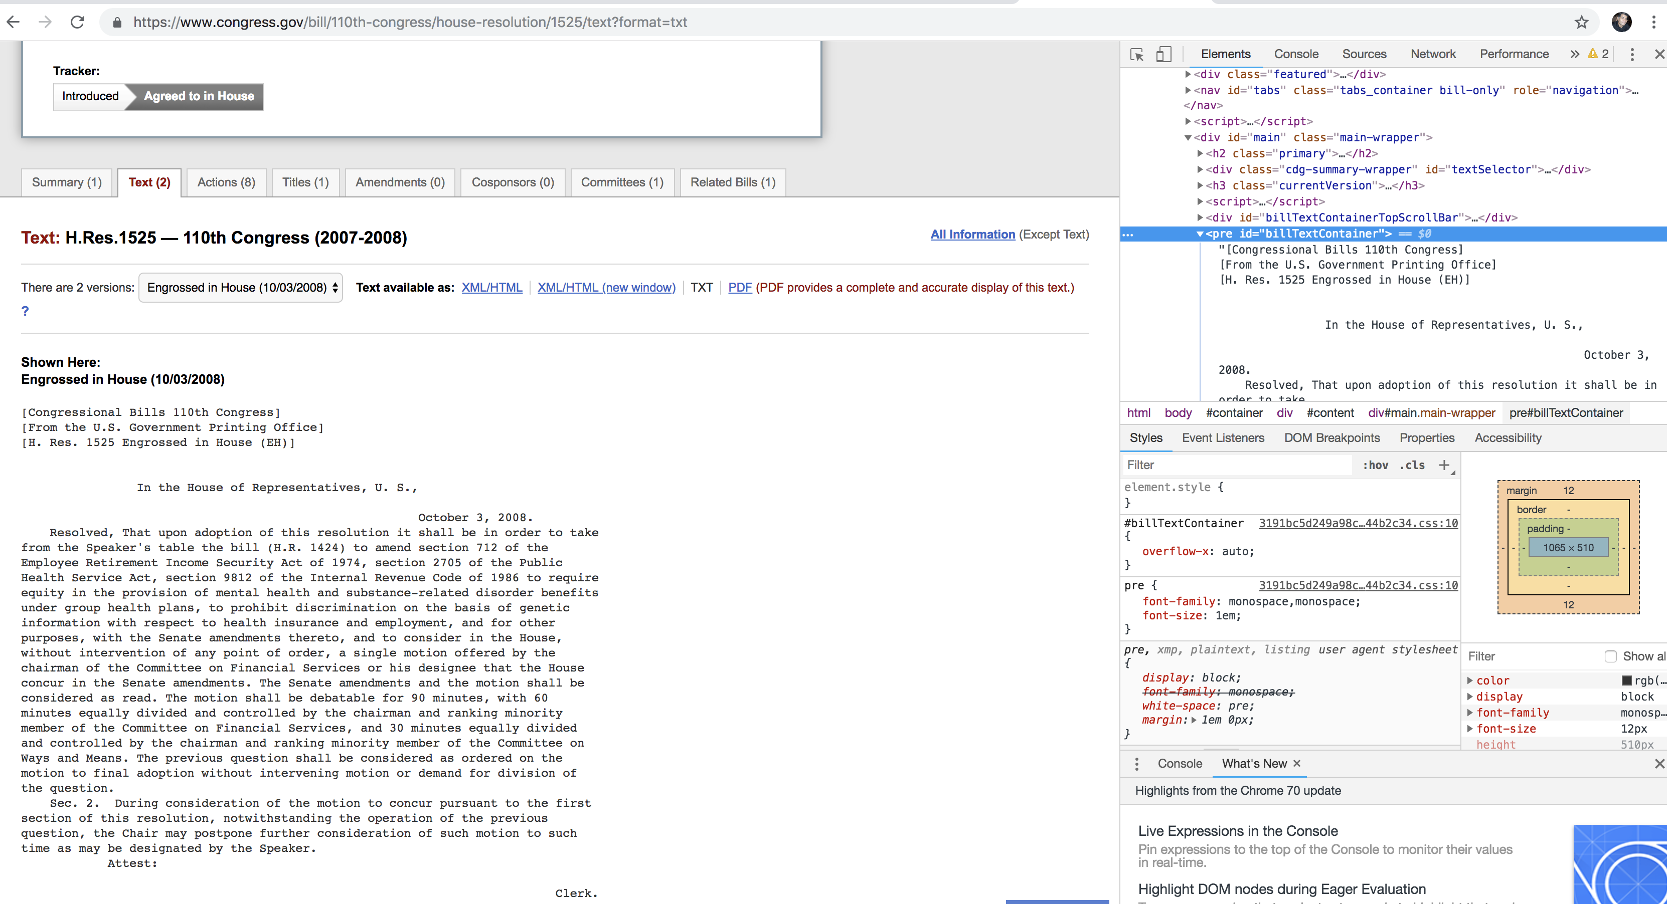
Data Collection
Used bill summary data to scrape the text of each bill. Wrote out to .jsonl file as it’s retrieved.

Slide 8
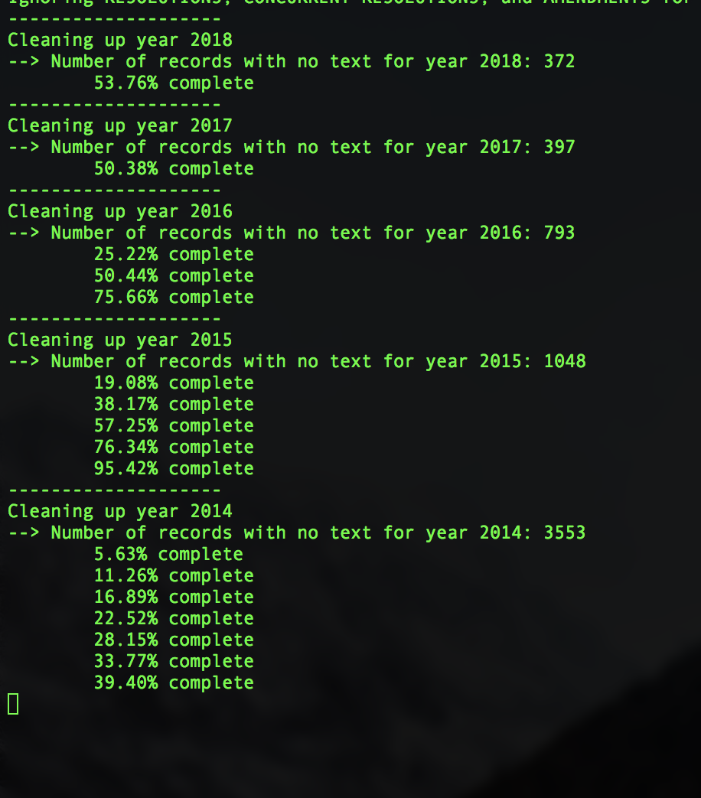
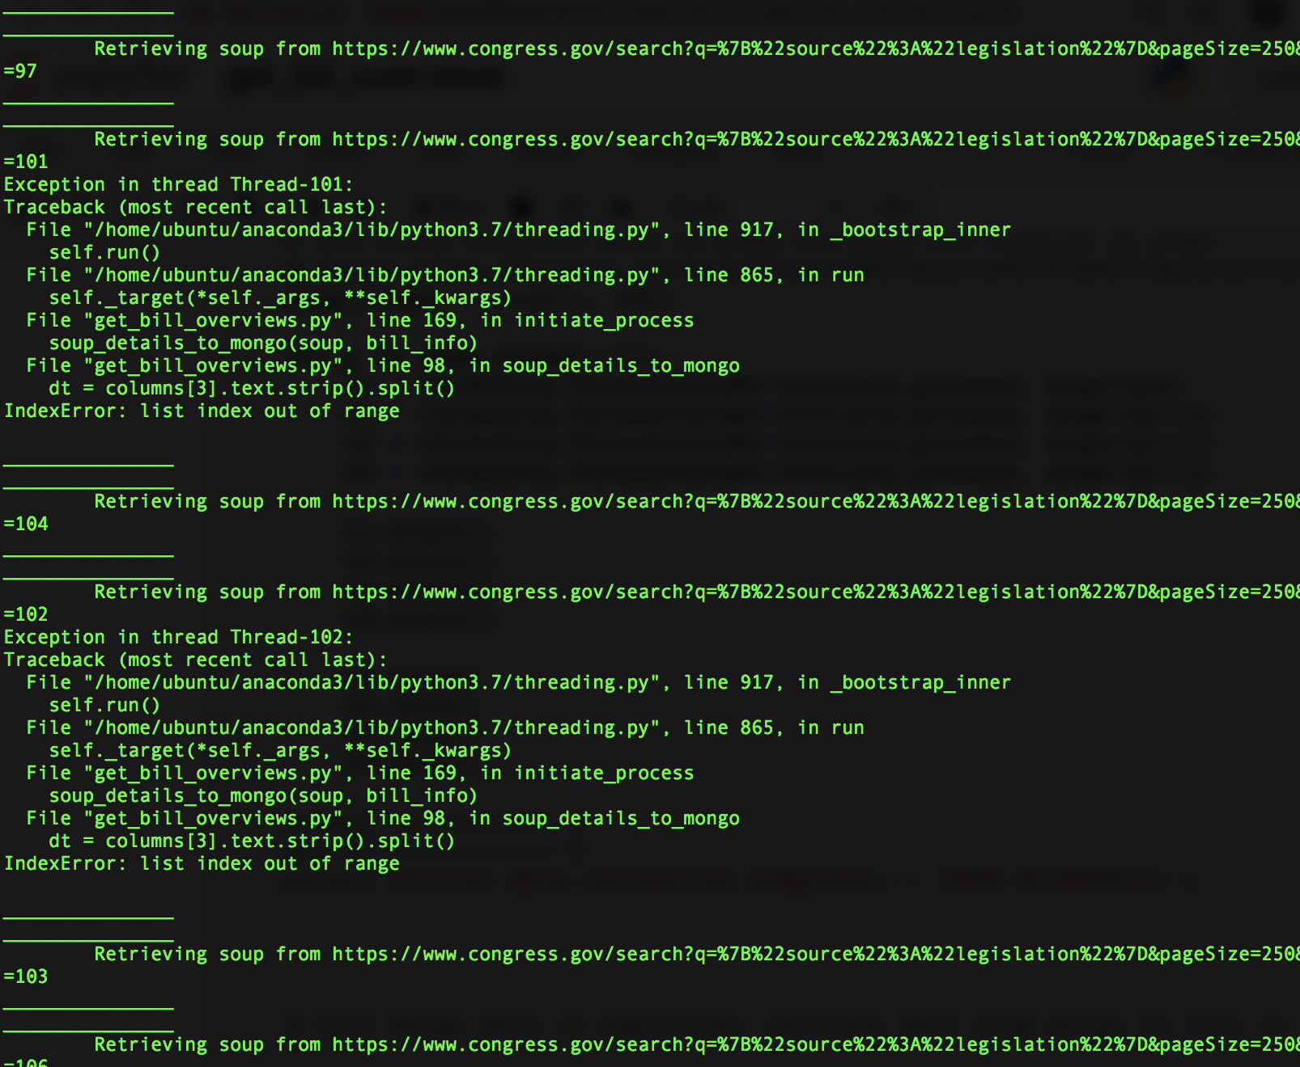
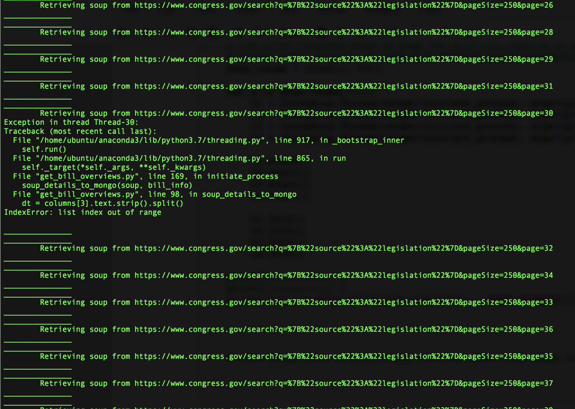

Slide 9
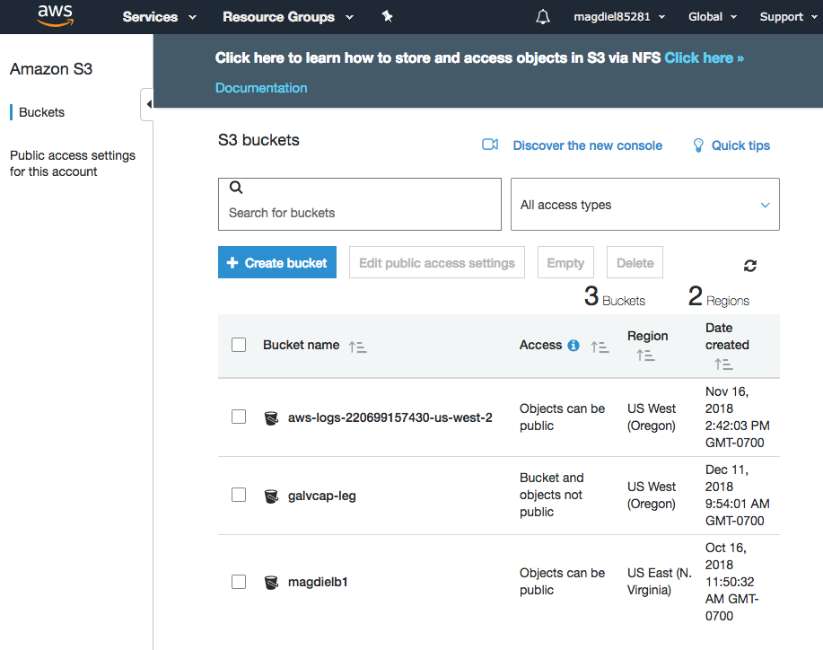
Amazon Web Services: Create an S3 bucket for our data.
Need to change access to write to the bucket galvcap-leg.

Slide 11
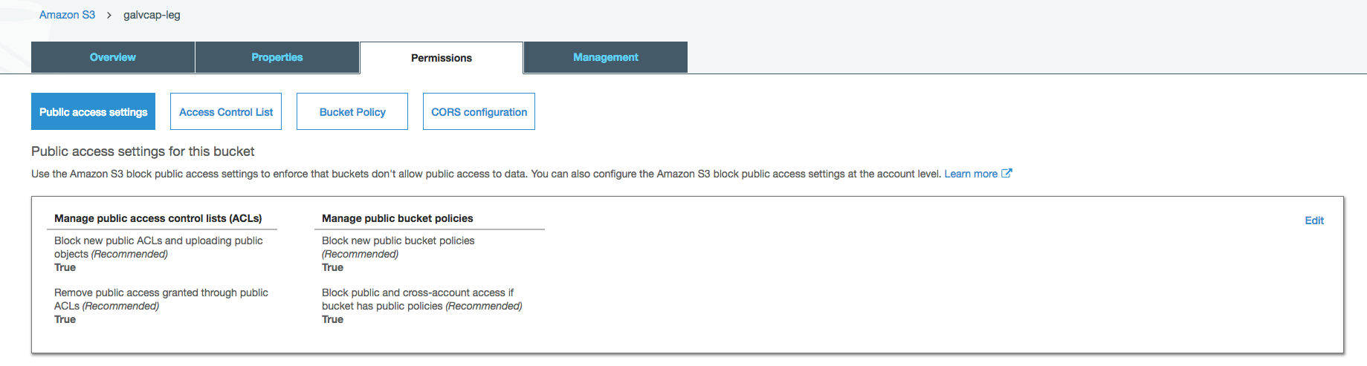
Amazon Web Services: Create an S3 bucket for our data.
Change all of the above values to False.

Slide 12
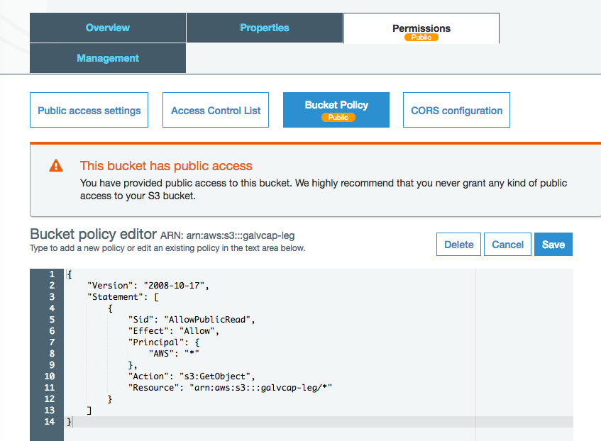
Amazon Web Services: Create an S3 bucket for our data.
Add the code below to change bucket policy.
Once the data is loaded, you may want to change access to the data so only the EC2 instance is able to retrieve what it needs.
{ "Version": "2008-10-17", "Statement": [ { "Sid": "AllowPublicRead", "Effect": "Allow", "Principal": { "AWS": "*" }, "Action": "s3:GetObject", "Resource": "arn:aws:s3:::<your bucket name>/*" } ] }

Slide 13
Bills and Joint Resolutions
Passed (1):
Not Passed (0):
In Progress (Null):
Became Law
Others
Previous Congresses
Current Congress
To President
Still on the Floor
Failed in One Chamber
Has Not Failed
Introduced
Beyond Introduction
Still In Original Chamber
Started in House and Passed Senate or Vice Versa

Slide 14
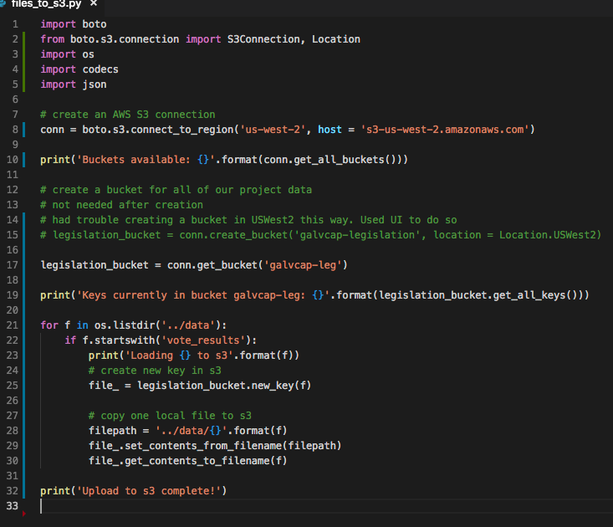
Code to upload to S3.
In order to avoid getting ERRNO 32 BROKEN PIPE, you need to specify host when initiating connection.

Slide 15
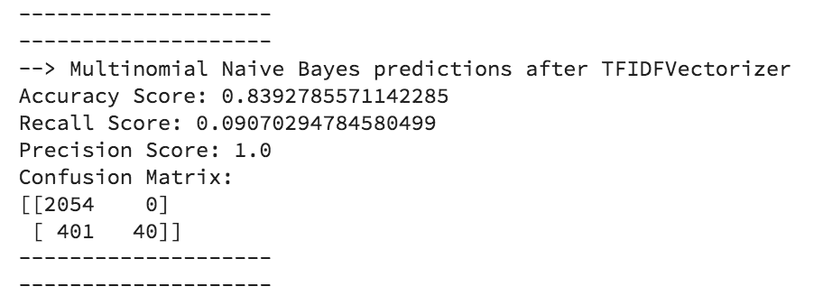
Natural Language Processing
TF-IDF: Term Frequency – Inverse Document Frequency
NLTK word_tokenize and stopwords
WordNetLemmatizer
Results of first iteration with subset of existing data as it’s still rolling in…

Slide 16
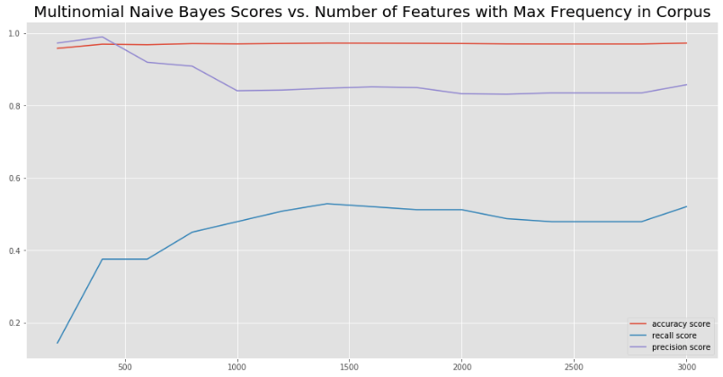
Examined how scores vary with the number of features with the highest frequency
Recall looks like it’s still going up…
Try a few more iterations

Slide 17
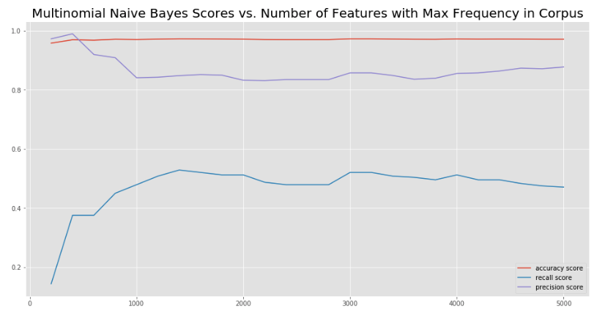
Doesn’t look like it’s improving much by increasing the number of features.
At this point, 3000 features seems to be the best without doing anything else to the model.

Slide 18
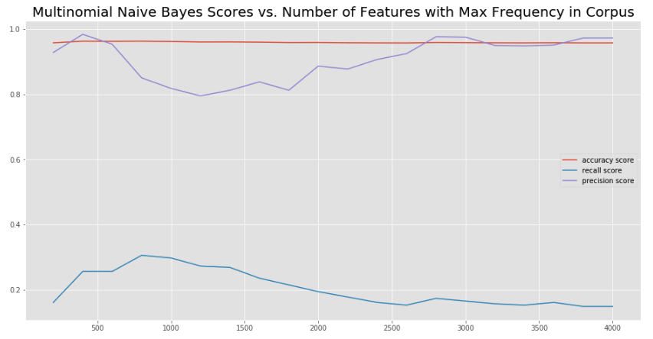
Alpha = 5
Recall maxes out at 800 features, but is only at around 3.5

Slide 19
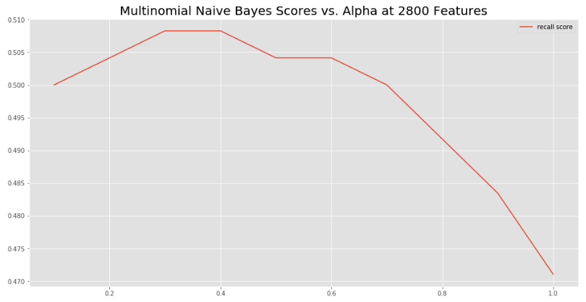
Our recall almost reaches .51 when alpha is between .3 and .4
Let’s up the features…

Slide 20
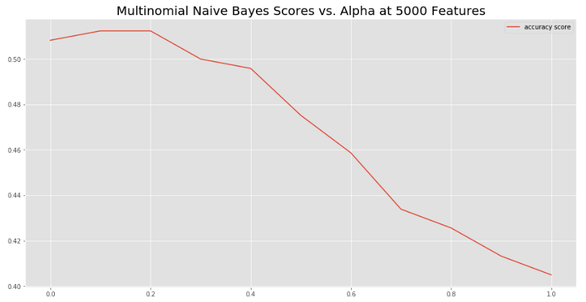
At 5000 features, alpha = 1.5 – 2 gives the best recall.
… splitting hairs at this point. Time to try some other approaches.

Slide 21
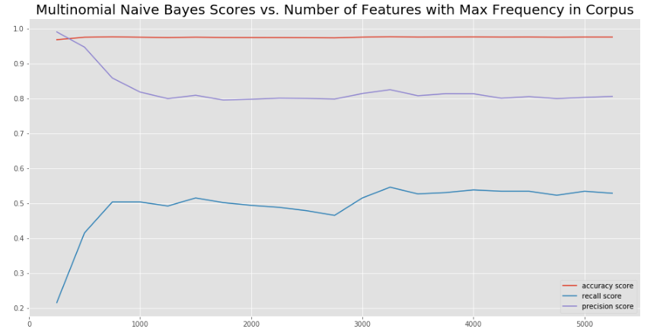

With a stratified train-test split the best recall score is specified below.

Slide 22
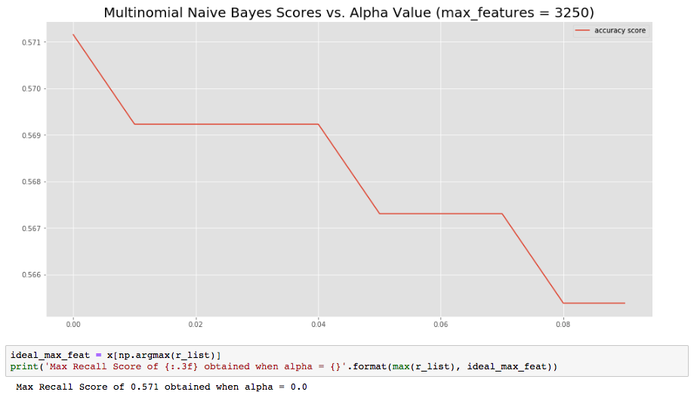
Keeping max_features at 3250, dial in the alpha in the Multinomial Naïve Bayes model

Slide 23
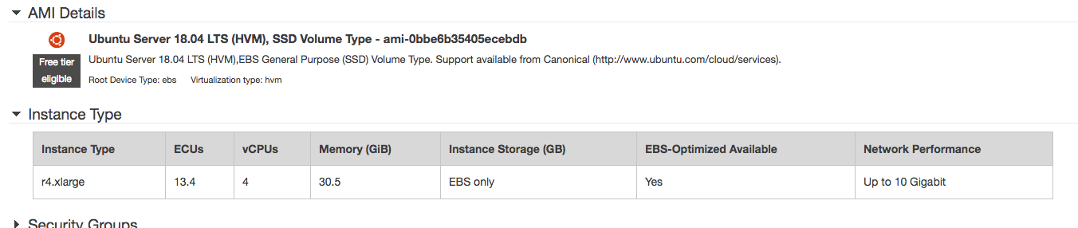
EC2 Instance

Slide 24
EC2 Instance
~/.ssh/config
Host galvanize_capstone
HostName ec2-34-221-255-8.us-west-2.compute.amazonaws.com
User ubuntu
IdentityFile ~/.ssh/galvanize_capstone.pem
Ssh galvanize_capstone
sudo apt update
sudo apt upgrade
wget -S -T 10 -t 5 https://repo.continuum.io/archive/Anaconda3-5.3.1-Linux-x86_64.sh -O $HOME/anaconda.sh
Source ~/.bashrc

Slide 25
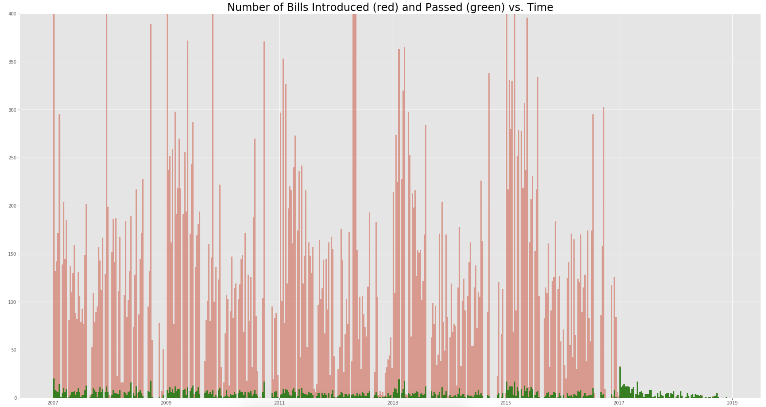
Trying to predict the bills that passed (in green)

Slide 26
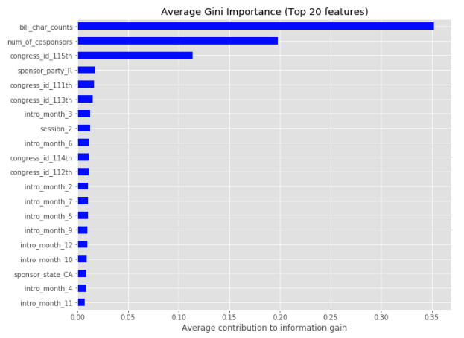
Random Forest Classification
Random Forest Classifier showing feature importance.
After looking at this, realized that the Congress ID will not be a part of the input data (every query will be from the most recent congress).
What happens if I take this out?

Slide 27
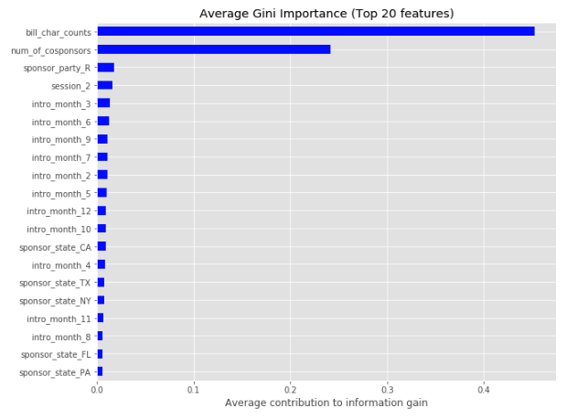
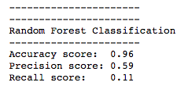
Random Forest Classification
Removing congress_id yields the following for feature importance…
Bill character counts and number of cosponsors are definitely important, but we get the following scores if we leave them in:
What happens if we remove them?

Slide 28
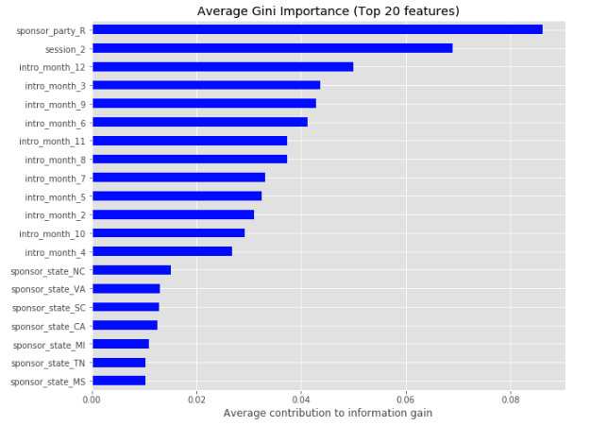
Random Forest Classification
With the dominating features removed, now we can see a little more detail on the importance of the other features.
In order to reduce the complexity of our model, we might be safe ignoring sponsor_state.
Our scores, though…

Slide 29
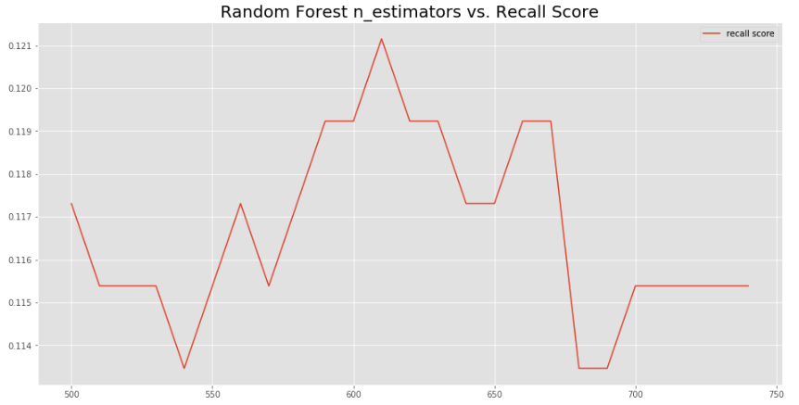
Random Forest Classification
Examination of how recall score varies with n_estimators.
Based on this, I set the n_estimators at 610

Slide 30
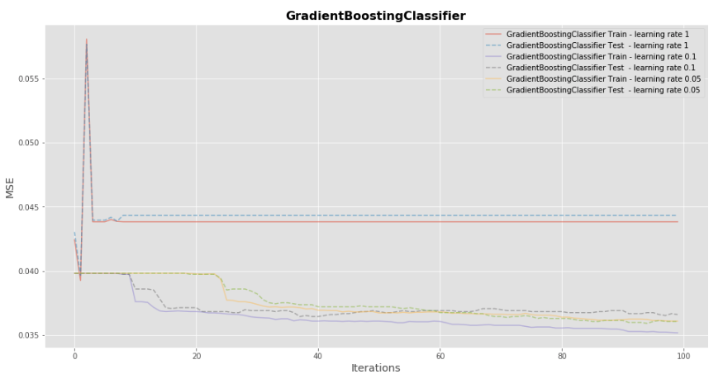
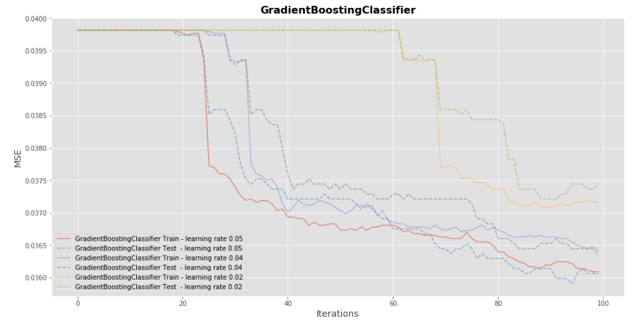
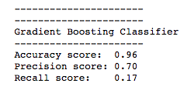
Gradient Boosting Classifier
With learning rate = .05, n_estimators = 100

Slide 31
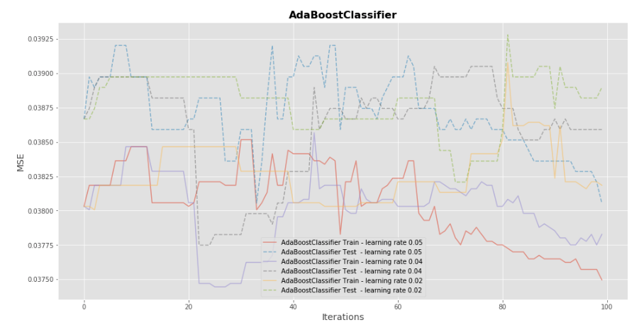
Max_depth = 3

Slide 32
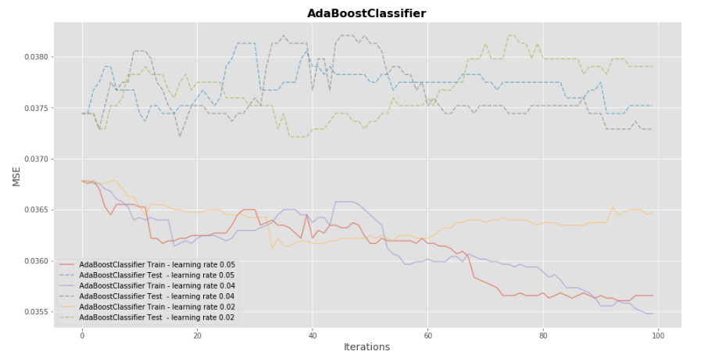
AdaBoost Classifier
Max_depth = 4

Slide 33
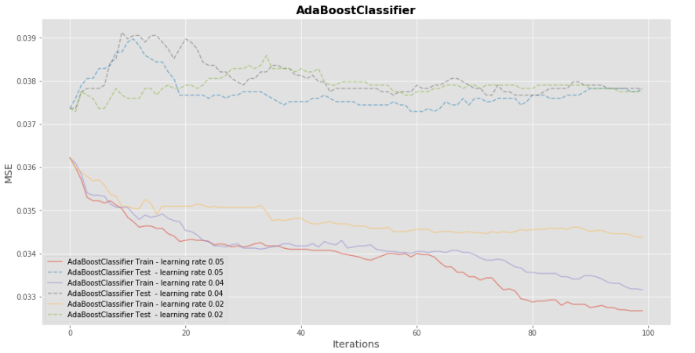
AdaBoost Classifier
Max_depth = 5

Slide 34
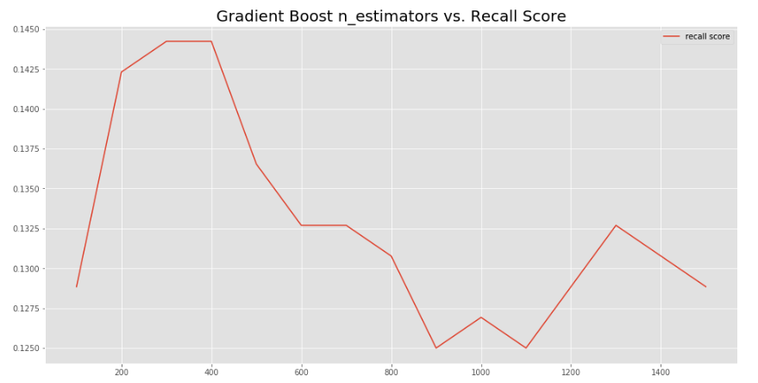
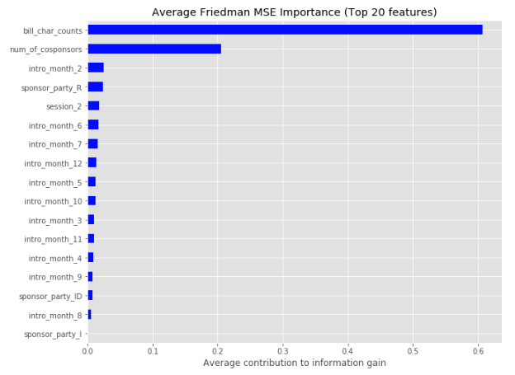
Trying the same by removing state
Learning_rate = .05

